Slide 1
People Experience Digital Transformation
Assess, Discover, and Activate the relevant strategies that help your organization actively improve Employee and Customer Experience

Slide 2
Why People Experience is on top of the agenda of every single corporate?
1
Technology is progressing very fast, with new digital-first players starting to dominate the world economy.
2
To adapt to this fast-changing environment and stay competitive, it is mandatory for all organizations to design and appropriately govern a people-focused Digital Transformation program.
3
At Atos, with our Digital NOW program, we are running our Digital Transformation focusing on transforming our Employee and Customer Experience, adjusting the way we work and the way we innovate.

Slide 3
Learning from our own experience to help transform your People Experience
Based on our experience we have built a framework and a platform that will help you identify your strategies to reach the next level in Employee and Customer Experience to improve your company performance.
The Atos People Experience framework and its supporting platform, links a broad network of indicators to the 6 defining angles of the People Experience (6E).
This model unlocks the identification of areas of attention that are critical for your organization, providing enough granularity to identify, design and measure strategic initiatives that address these areas at the right level (global, by geography, by persona).

Slide 4
Our Proven Framework is supporting discover and steering your initiatives to improve your productivity, employee retention and customer experience
Atos People Experience Framework
Tech Experience
Right, stable tools and appropriate support; i.e.
Core tooling crashes
Digital App adoption
Enabled
Empowered
Wellbeing / Culture
Rest as a driver of increased productivity; i.e.
GPTW / Voice of the Employee
Work done outside business hours
Focus Time
Removing waste, distractions from the day-to-day; i.e.
Meeting / Email Analytics
Wandering/Movement Waste
Efficient
PX
Learning & Development
as part of employee Onboarding process; i.e.
Training analytics
Onboarding Experience
Educated
Employee Management
Perception of employee of the support from management; i.e.
Employee satisfaction score
Management trust index
Network, collaboration
Access to the people and resources needed to succeed; i.e.
Community analytics
Communication effectiveness
Enhanced
Engaged
Business
Outcome
Retention
Productivity
Growth / CX

Slide 5
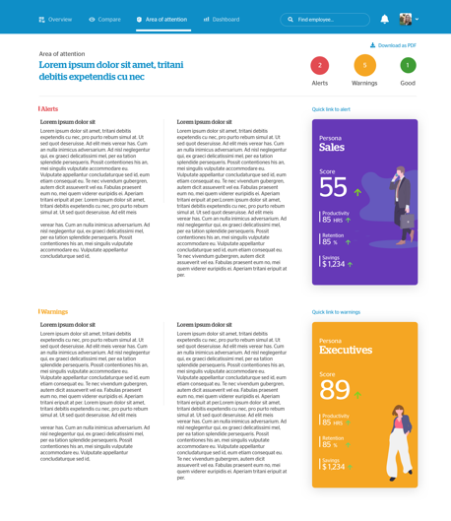
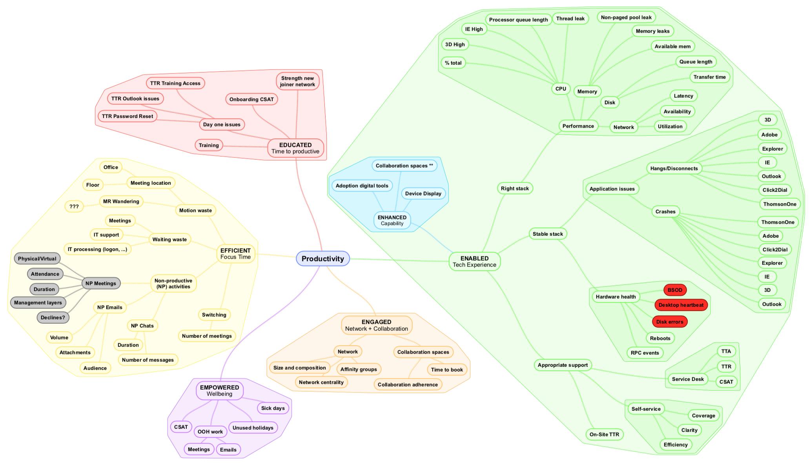
The platform facilitates collecting many indicators and mapping them to the different angles of People Experience (6E). This helps organizations better understand behaviors and correlations. Visually, the tree map structure of these indicators in the platform, helps users identify the different areas of attention (clusters) in the organization and understand the personas (segments of population) impacted (i.e. gen-Z onboarding experience, device performance of sales teams, …):
1M+ different personas can be built in the platform, enabling the correlation of issues with the segments of population affected by them; for example: strategies by generation, monitoring of new joiners and diversity objectives; comparing experiences across different geographies, buildings, …
HR
Educated
Enabled
Tech
Enhanced
Identify areas of low data density (i.e. not gathering the right data to listen to the voice of the employee or not enough data points to calculate your Digital Experience) – and define data improvement projects based on them
Productivity
By looking at the clusters with issues in the overview of KPI, organizations can identify the areas of attention that will help define the strategic actions in their Digital Transformation plan.
Examples: focusing on the right areas of digital workplace to transform, changing specific steps of the employee onboarding experience, or prioritizing smart tech deployment to the right buildings/floors
Tech/CS
Efficient
HR/CS
HR
Engaged
Empowered

Slide 6
Atos is your partner for transforming your Employee Experience, taking your company performance into the next level
The Atos value
Digital NOW has been recognized in the market as a proven framework to successfully execute a Digital Transformation, ranked #1 within CAC40 by Forbes.
As a trusted Digital Partner of our customers and based on our experience and lessons learned, Atos is in a privileged position to support you navigate your end-to-end Digital Transformation journey.
Atos considers one of the key drivers of this transformation the Employee Experience, as it is a key enabler to boost your customer experience, company performance, and employee retention, and can set a solid foundation for a broader Digital Transformation.
Our approach
Atos has developed a framework and platform to assess, baseline, measure, govern the different employee experience strategies:
Based on a 360-view of the employee¹ to provide a personalized Employee Experience (EX) score for your organization.
Supports management of strategic objectives.
Enables setting and following the right strategies for each segment of population (persona-based).
In less than 3 months, Atos can help assess and baseline your EX, helping you to set the right target and actions to secure your strategic plans.
After this first step, Atos will support your execution to deliver impact in productivity, employee and customer experience.
¹This includes data from areas as diverse as: Voice of the employee, Technology/IT experience, Employee proactive participation on programs, Sense of purpose, productivity, …

Slide 7
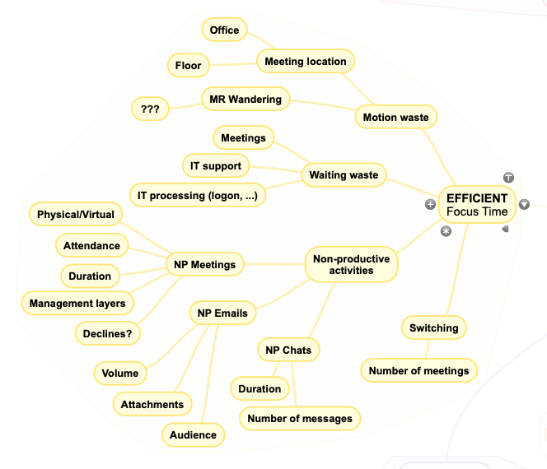
Platform Zoom In – how does it work?
Efficient » Focus time
Multiple factors and channels influence the ability of an employee to focus and be productive
THEORETICAL REASONING – looking for wastes:
PLATFORM PROPOSAL
All day
Wandering time (search MR…)
Physical office moves (floor, location)
Efficient
Waiting at / for Meetings
General criteria for unproductive meeting time (MSFT)
Meetings beyond certain duration
With high number of declines
With multiple layers of management
With a lot of participants
Unproductive meeting time
Productive meeting time
IT waiting (logon, load apps,..)
IT support wait
Non-productive email
Productive email
Other distractions
Sources:
Motion: Meeting analytics + TBD
Waiting: IT SLA + Meeting details
NP Meetings: Meeting analytics
NP Emails: Email analytics
NP Chats: Chat analytics
Switching: Meeting analytics
Focus time

Slide 8
The structured definition of KPI and Personas is the base to structure experience-driven strategies
The platform enables the collection and consolidation of KPI, facilitating the organization setting strategies around Employee Experience
1
Look at individual values to establish actions to address outliers / at risk
3
1
2
Use personas as strategy drivers, track their progress
2
3
Help you understand the impact of current or future initiatives

Slide 9
The structured definition of KPI and Personas is the base to structure experience-driven strategies
2
Use personas as strategy drivers, track their progress
3
Help you understand the impact of current or future initiatives
Set
population
(personas)
in scope
Set
KPI
scope
See overall evolution
Set start
date
(baseline)
Track by persona
Track
Act
Follow by strategic initiative
Set targets
(date +
Values)
See link to framework drivers
Calculate
Expected
Impact

Slide 10
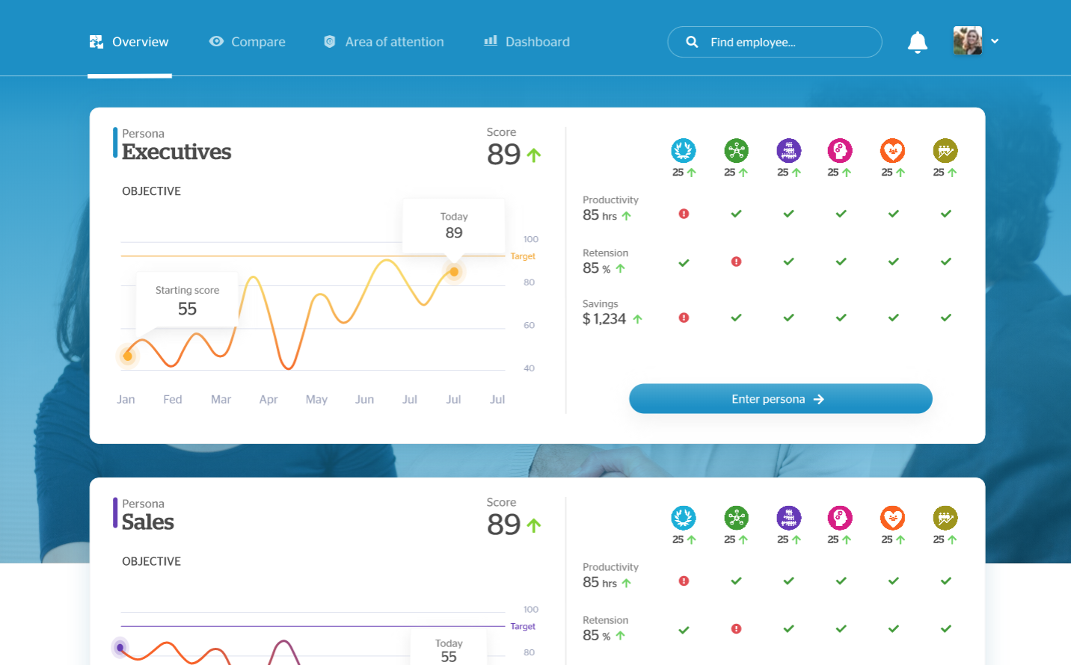
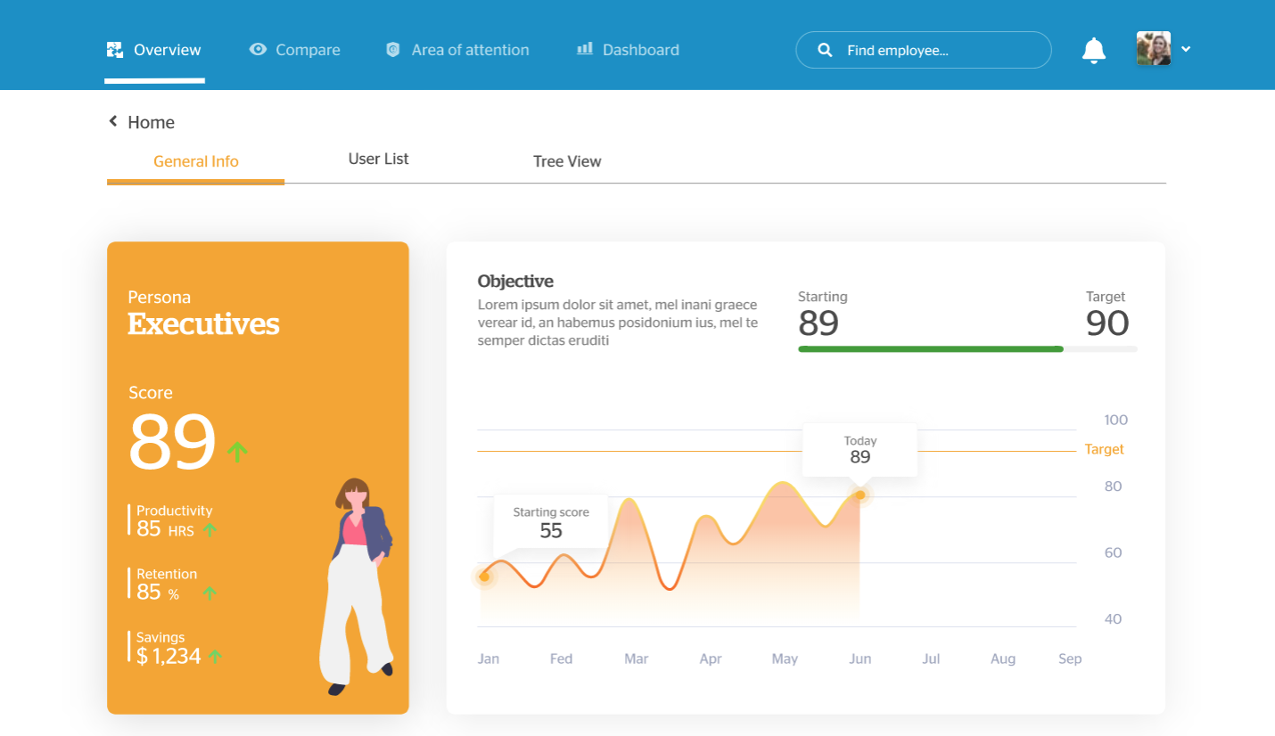
Follow up on all detail you require to better understand your personas and organization
Detail Screens

Slide 11
Thank you!
Contact me for more details
Javier Ponce
Global Head of Digital Transformation
Javier.ponce@atos.net

Slide 12
APPENDIX

Slide 13
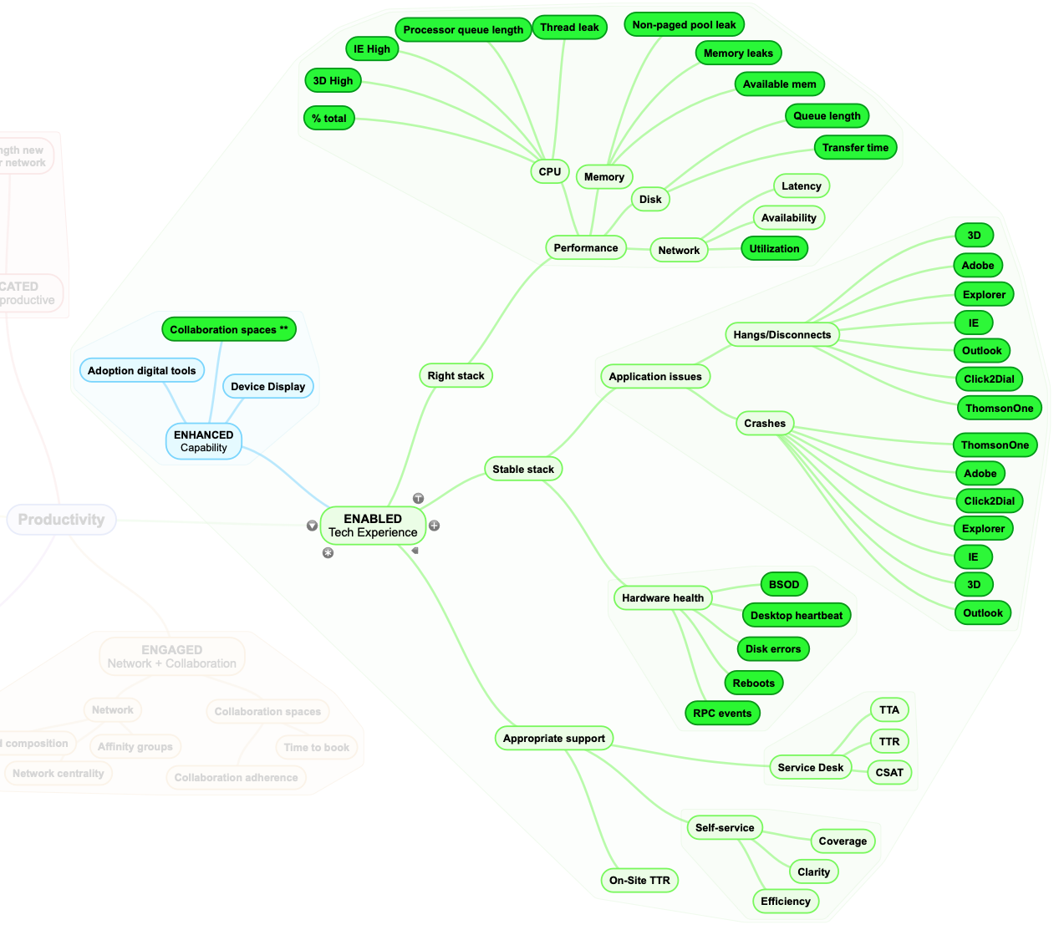
Enabled » Tech experience
For some personas, the experience behind tech will be a critical driver of performance
THEORETICAL REASONING
PLATFORM PROPOSAL
Technology Experience
Enabled
=
Enhanced
Access to the right tech stack
Performance (memory, CPU, Disk, Network)
Capability
+
Stability of the Stack:
Application issues
Hardware health
+
Sources:
Performance: Systrak logs
Application issues: Systrak logs
Hardware health: Systrak logs
Support: SD tickets
Capabilities: BRAIN + ESpaces
Appropriate support
Service Desk (service + CSAT)
Self-Service (service + CSAT)
On-Site (service + CSAT)

Slide 14
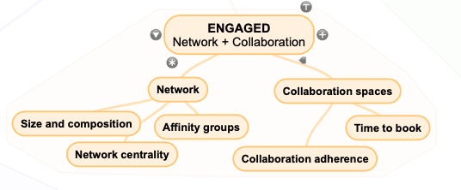
Engaged » Network, collaboration
Strong professional networks and collaboration mechanisms are correlated with better results
THEORETICAL REASONING
PLATFORM PROPOSAL
One of the key behaviors of successful, productive work is having a large and healthy network in your own organization
Source: Behaviors that drive successful salespeople
(by Ryan Fuller, Harvard Business Review, 2014)
Engaged
Organizational Network Analysis allows organizations to identify the relative strength of individual networks, as well as the key players for Digital Transformation:
Sources:
Network: Meeting analytics (proxy)
Collaboration spaces: Meeting analytics + ESpaces
Training: HR data
Source: deloitte

Slide 15
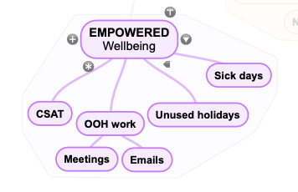
Empowered » Wellbeing
The importance of wellbeing for productivity can be critical in certain populations
THEORETICAL REASONING
PLATFORM PROPOSAL
We know that investing in health and wellbeing can improve productivity, as the following examples show.
The London School of Economics analyzed data from the Royal Mail, where an investment of £45 million [in wellbeing initiatives] generated a £225 million return on investment from 2004 to 2007. The study concluded that, were the 13 worst-performing sectors to follow suit, the impact on the UK economy could be £1.45 billion (Marsden and Moriconi, 2010).
NHS Trusts that score highly on the health and wellbeing index (measured annually through the NHS Staff Survey) have better performance across a range of measures, including financial, spending on agency staff, patient satisfaction and fewer acute infections.
An organization that changed its focus to skills and abilities (e.g. training on safety and communication), motivation (e.g. reward-based management) and job design saw a small improvement in job satisfaction (8 per cent), but had a bigger impact on productivity (up by 14 per cent). After the intervention, there was also a 24 per cent reduction in time delays, a 33 per cent reduction in accidents and a 77 per cent reduction in lost-time incidents (Tregaskis et al, 2013).
Empowered
Sources:
CSAT: Employee CSAT surveys
OOH work: Meeting analytics + Email analytics
Unused holidays: HR data
Sick days: HR data

Slide 16
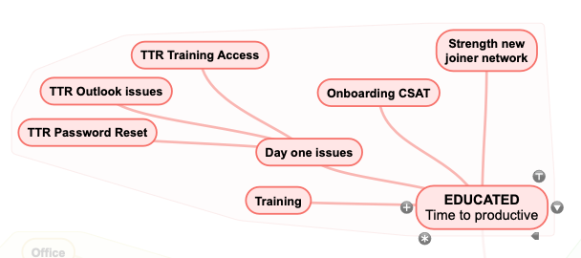
Educated » Time to productive
Several elements of an employee onboarding are critical for the productivity mid-term
KEY REASONS
PLATFORM PROPOSAL
1
You want the new employee excited about their job and on the fast track to productivity through proper onboarding practices
Educated
2
Implement the appropriate training technologies to make it easy for employees to access training and onboarding from anywhere.
3
Help new joiners understand the company's mission, values and goals propel the new model of the workplace.
Sources:
Day one issues: GSAG / IMAC / SD tickets
Onboarding CSAT: ?
Strength new joiner network: Network analysis filtered down to new joiners
+ The quality of a newcomer’s network dramatically decreases time to productivity and odds of unwanted attrition.

